Slide 1
Session 18
Introduction to Sun Java Studio Enterprise 8

Slide 2
Review 2-1
An Applet is a Java program that can be executed with the help of a Java enabled browser.
Every user-defined Applet must extend the java.applet.Applet class.
A user-defined Applet inherits all the methods of Applet class.
<applet>..</applet> tags are used within an HTML file to embed a class file.
The default layout for an Applet is FlowLayout.
Images can be drawn on an Applet by means of the paint(), getImage() and drawImage() methods.
Whenever the user performs an action such as moving the mouse, pressing a key, releasing the key and so on, an event is generated. We can make use of event handler classes and interfaces to handle these events.

Slide 3
Review 2-2
Event handling in Applets in the simplest form can be handled by overriding the mouseDown( ), mouseUp( ) , and mouseDrag( ) methods.
The Graphics class is used to draw objects like text , lines ovals and arcs on the screen.
The Font class is used to make text look attractive in the output of a Java program.
The FontMetrics class is used to obtain information about a Font.
GraphicsEnvironment class has methods to get information about the available fonts in the system.
The Color class is used to add colors to an application or Applet.

Slide 4
Objectives
Create a Java Studio Enterprise 8 Project
Create Java Class in Java Studio Enterprise 8
Compile and Run a Java Application
Debug in Java Studio Enterprise 8

Slide 5
Java Studio Enterprise 8
Netbeans 5.0
Sun Microsystems
Design
Java
Studio
Enterprise 8
Develop
Interface for User
Test
Deploy
IDE for Java
Manage

Slide 6
Creating Project 4-1
A project is a collection of files and other information that makes up a Java program.
A project is created for each and every program written in Java Studio Enterprise 8.
Java Studio Enterprise 8 creates a folder for every project to record information about the project.
Click on Start → Programs → Sun Microsystems → Java Studio Enterprise 8 → Start Java Studio Enterprise to start the IDE.

Slide 7
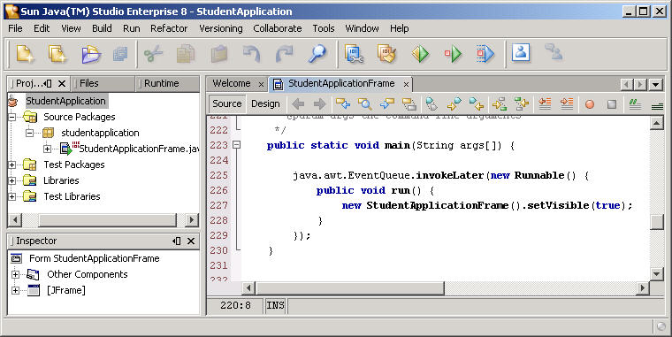
Creating Project 4-2
Menu Bar
Toolbar
Source Editor
Projects Window
Inspector Pane

Slide 8
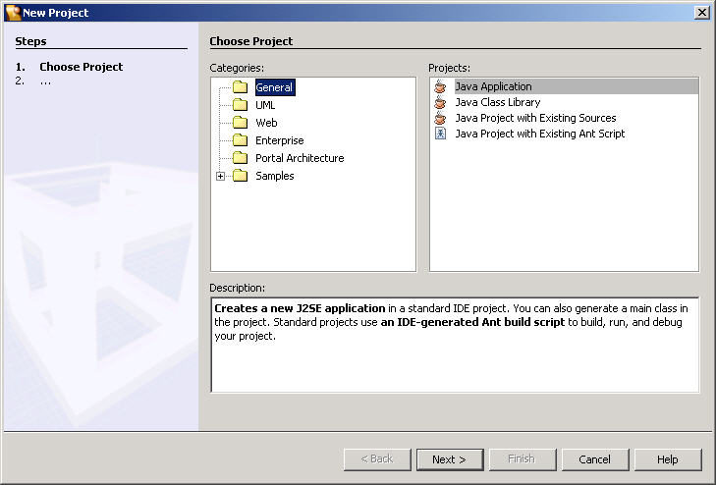
Creating Project 4-3
Click File → New Project
Project Type

Slide 9
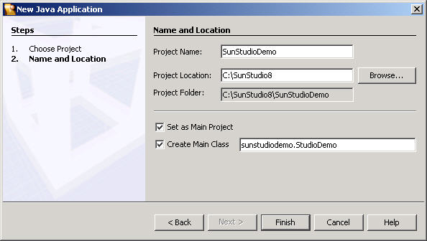
Creating Project 4-4
Click Next
Enter name of project
Creates a main class in project

Slide 10
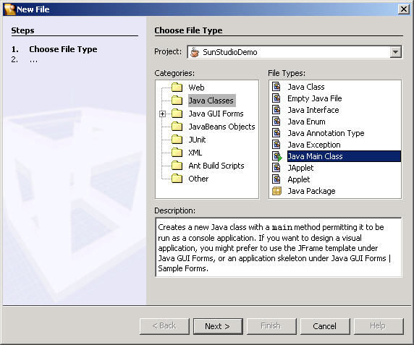
Creating Class 2-1
Click File → New Class
Selecting Base Class
Type of Class

Slide 11
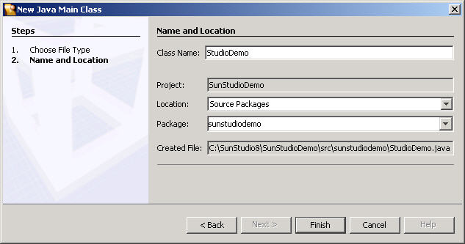
Creating Class 2-2
Click Finish
Package name
same as
Project name

Slide 12
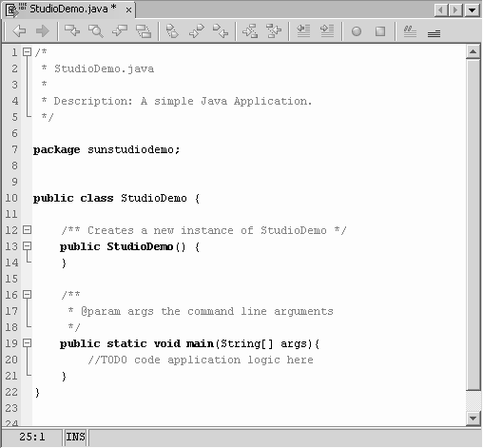
Code for Java Studio Enterprise 8 Example 3-1
Javadoc comments
Package name
Class generated
Main method

Slide 13
Code for Java Studio Enterprise 8 Example 3-2
Create file
...
File file = new File("C:\\Demo.txt");
...
BufferedWriter out = new BufferedWriter(new FileWriter(
"C:\\Demo.txt"));
out.write("apple\n");
out.write("pineapple\n");
out.write("orange\n");
out.write("banana\n");
out.write("tomato");
...
Write file
Demonstration: Example 1

Slide 14
Code for Java Studio Enterprise 8 Example 3-3
BufferedReader in = new BufferedReader(new FileReader(
"C:\\Demo.txt"));
...
while ((str = in.readLine()) != null) {
v.addElement(str);
System.out.println(str);
}
Reads file contents into a vector
while (v.size() != 0) {
String printLine = (String) (v.elementAt(0));
int linenumber = 0;
for (int ctr = 1; ctr < v.size(); ctr++) {
if (
((String) v.elementAt(ctr)).compareTo(printLine) > 0) {
printLine = (String) v.elementAt(ctr);
linenumber = ctr;
} // end-if
} //end-for
Sorts the content

Slide 15
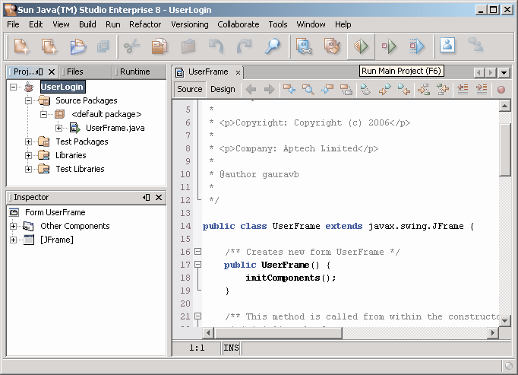
Compiling & Executing 2-1
Click Run → Run Project to compile and run the project.
Compile and run the project

Slide 16
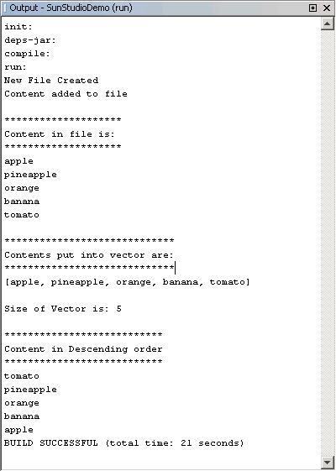
Compiling & Executing 2-2
Initiation of the Build operation
Output displayed in the Output pane of the IDE.
Output of the project
Result of the
Build operation

Slide 17
Debugging in Java Studio Enterprise 8 7-1
Debugging is the most important feature of Java Studio Enterprise 8.
Logical errors cannot be detected by Java.
Debugging is usually the process of finding and solving logical errors.
An interactive debugger is used rather than reading the program and tracing the logical errors.

Slide 18
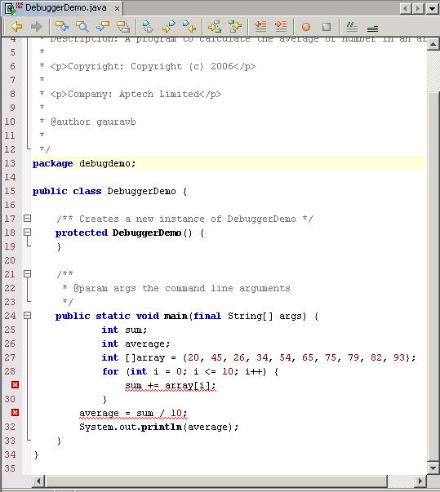
Debugging in Java Studio Enterprise 8 7-2
Demonstration: Example 2
Error nodes
Errors

Slide 19
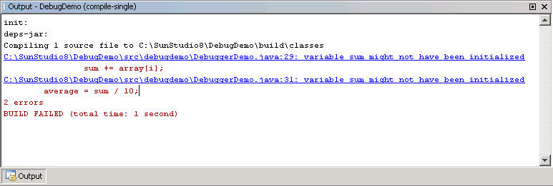
Debugging in Java Studio Enterprise 8 7-3
Error line number
Error message

Slide 20
Debugging in Java Studio Enterprise 8 7-4
BreakPoint
Debugger
for (int i = 0; i <= 10; i++) {
sum += array[i];
}
average = sum / 10;
System.out.println(avg);
BreakPoint
Memory
Looks into
Traces breakpoint

Slide 21
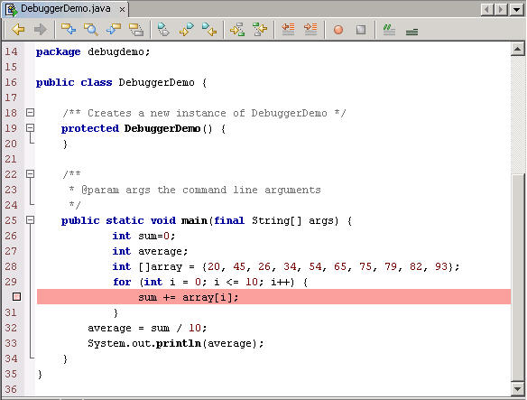
Debugging in Java Studio Enterprise 8 7-5
Setting a BreakPoint
Sets breakpoint

Slide 22
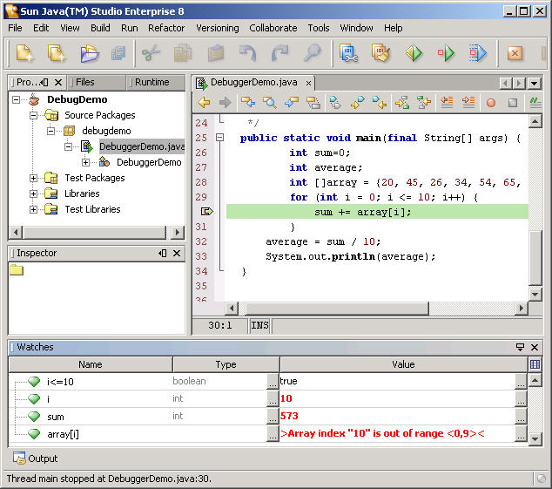
Debugging in Java Studio Enterprise 8 7-6
Debugging Center
Errors
Tabs for
multiple views
Watch expression values

Slide 23

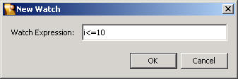
Debugging in Java Studio Enterprise 8 7-7
Click watch icon
Click
Add expression to
be checked

Slide 24
Summary
Java Studio Enterprise 8 IDE is an interface for users to design, develop, test, deploy and manage Java applications.
A project is a collection of files that make up a Java program.
Each and every program written in Java Studio Enterprise 8 has to be in the context of a project.
Debugging usually detects logical errors. The most widely used debugging tools are the breakpoints and the watches.
The error messages displayed in the output pane describe the errors.

